Slide 1

PREDICT THE STOCK PRICES WITH DEEP LEARNING
Presented by TANGARI MAURO

Slide 2




PROJECT TASK
Stock price prediction is a complex task in finance and machine learning, involving the forecasting of future stock prices based on historical data and relevant features like trading volume, technical indicators, and market sentiment.
This project focuses on utilizing two prominent approaches: Transformers, including BERT models, and Bidirectional Long Short-Term Memory (Bi-LSTM) models.
The project encompasses the design, implementation, and evaluation of deep learning models tailored for stock price prediction. It begins with individual exploration of Transformer and BiLSTM architectures and culminates in the development of a hybrid model combining both. The dataset comprises historical stock prices of four key companies—Google, Microsoft, Amazon, and Apple—listed on the NasdaqGS market. The project's objective is to predict the next-day, 2-days-after, and next-week stock prices for Open, High, Low, and Close values for each of these companies.

Slide 3
UTILS
GOOGLE COLAB
PYTHON
TENSORFLOW
KERAS

Slide 4
CONTENTS
01
02
03
04
RECALLS
DATASETS &
DATA-PRE PROCESS
DEEP LEARNING MODELS
MODEL EVALUATION & RESULTS

Slide 5


01
DATASETS

Slide 6

DATASETS INFO
The datasets used were from Yahoo Finance and concerned the companies: Amazon, Apple, Microsoft and Google and all of these have the same date range from 21-August 2019 to 18-08-2023, so 4 years of day-by-day values.

Slide 7







STRUCTURE OF DATASET
[1005 rows x 7 columns]
Date | Open | High | Low | Close | Adj Close | Volume
2019-08-21 | 53.23 | 54.16177 | 52.69 | 51.4918 | 51.5 | 61.883
2019-08-22 | 53.19416 | 54.6662 | 52.157 | 52.714 | 52.7 | 60.86
2019-08-23 | … | … | … | … | … | …
2019-08-24 | … | … | … | … | … | …
… | … | … | … | … | … | …
2023-08-17 | 50.84 | 51.81 | 52.87 | 51.83 | 51.8 | 62.932

Slide 8

DATA PRE PROCESS
STRING TO DATETIME
DROPNA
convert a date string into a datetime object.
Removal of missing or null data
NORMALIZATION
FEATURE & TARGET
Data Normalization with min-Max tecnique.
Feature and Target: Open, high, Low, Close and Volume
SPLITTING DATA
INPUT & OUTPUT 3D
The data from X and Y are divided into 80% Training, 20% Validation and 20% Test
Addition of a fictitious time dimension for both features and targets.

Slide 9

02
RECALLS

Slide 10
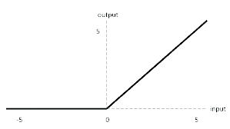

ACTIVATION FUNCTIONS
Activation functions are key components in artificial neural networks and are used to introduce non-linearity into models. These functions determine whether an artificial neuron should be activated (firing) or not based on the weighted sum of its inputs.
Activation functions play a key role in neural networks for several reasons:
Introduction of Non-Linearity
Hierarchical Feature Learning
Information Management
The activation function used in this project is the ReLu (Rectified Linear Unit).
It is a non-linear activation function that returns the input itself if it is positive and zero otherwise.

Slide 11

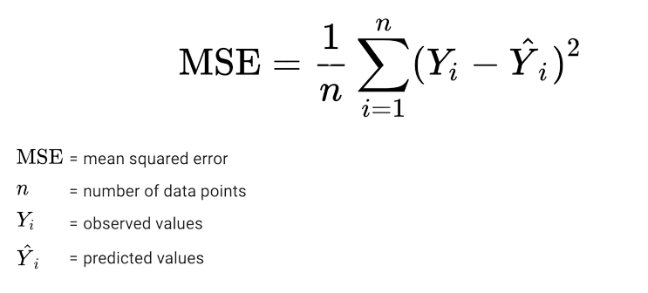
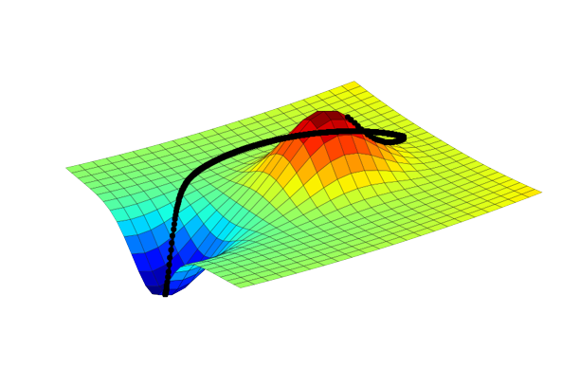
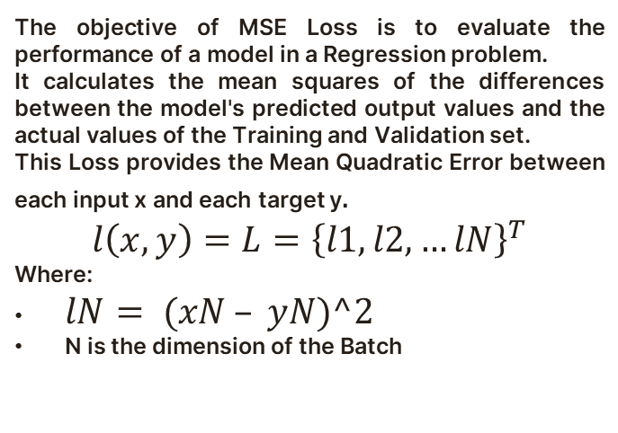
MSE LOSS
The objective of MSE Loss is to evaluate the performance of a model in a Regression problem.
It calculates the mean squares of the differences between the model's predicted output values and the actual values of the Training and Validation set.
This Loss provides the Mean Quadratic Error between each input x and each target y$.$
$$l\left(x,y\right)=L={\left\{l1, l2, …lN\right\}}^{T}$$
Where:
$lN= (xN – yN)^2$
N is the dimension of the Batch

Slide 12

GRADIENT DESCENT
The Gradient descent is an optimization algorithm commonly used in the training of deep learning models to find model parameter values that minimise the Loss Function.
The algorithm in deep learning works like this:
initialisation of weights
calculation of the gradient
weight adjustment
repetition of steps 2 and 3 for a specified number of epochs

Slide 13
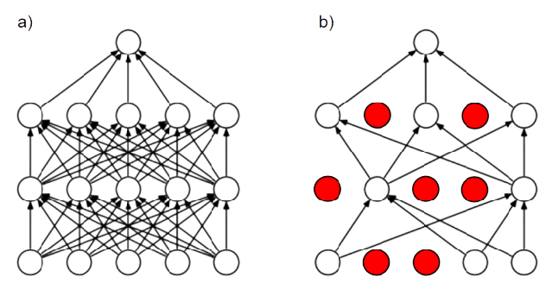
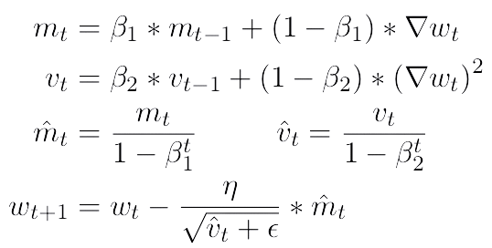
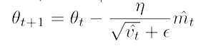
OPTIMIZER: ADAM
Adam is a method that calculates the adaptive learning rate for each parameter and stores the exponential decay average of past quadratic gradients for each time step t like the Adadelta and RMSprop optimisers, but also stores one similar to Momentum.
So we have:
Mean of the gradients mt
Uncentred variance of the gradients vt
Adam's parameter update rule is:

Slide 14
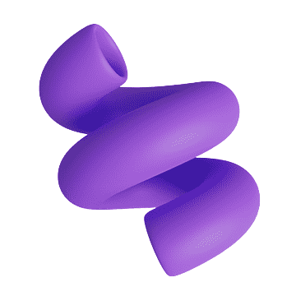


DROPOUT
Dropout is an efficient way of averaging many large neural networks.
This technique works like this:
During Training a percentage, at random, of units in one or more layers of the network is temporarily dropped out.
Then during the training iteration some connections are disregarded.
It is not applied during the Test process.
Usually the dropout value is 0.2 or 0.5 but can also be adjusted.
This technique can be implemented with the dropout layer that randomly introduces binary masks (0, 1) into the units during training:
1 Active
0 Not Active
With the Dropout we have:
Greater robustness
Less overfitting
Less dependence on specific connections

Slide 15
03
MODELS

Slide 16
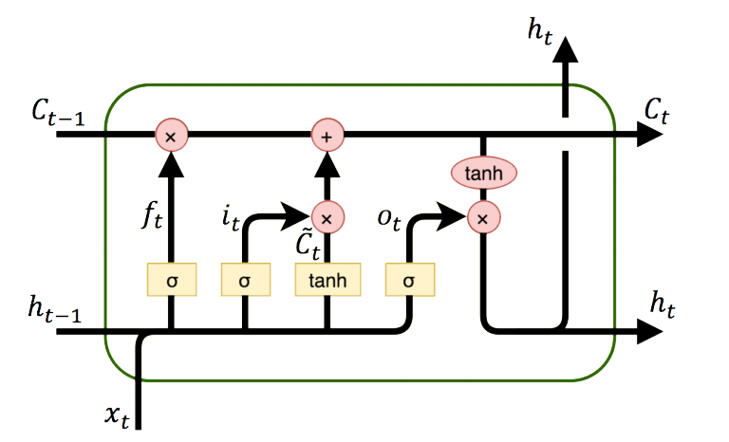
MODELS
1
2
3
4
TRANSFORMER-ENCODER
BI-LSTM
HYBRID
(MIXTURE MODEL)
HYBRID
(with WEIGHTED ATTENTION)

Slide 17
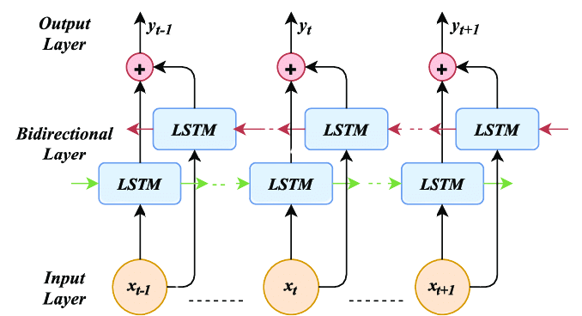
LSTM
An LSTM network is an advanced recurrent neural network (RNN) that is designed to solve the problem of long-term dependencies handle problems where the temporal sequence of data is important, in fact they have an internal memory that can store long-term information and allow information to flow from one temporal state to another.
There are 4 gates that control the flow of information in memory cells:
FORGET
STORE
UPDATE
OUTPUT

Slide 18

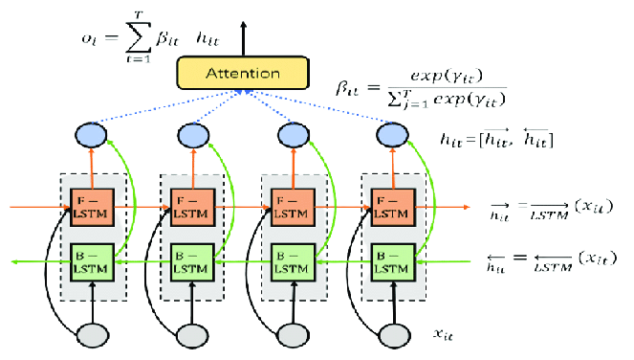
BI-LSTM
A Bi-LSTM network functions similarly to a normal LSTM, but has some key differences:
Two-way
Chained Output
Greater Capability of Capturing Time Dependencies

Slide 19
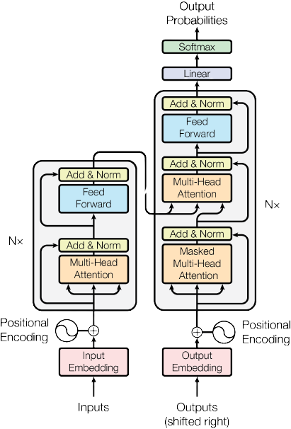
WHY BILSTM + ATTENTION
Bi-lstm models are able to keep track of past and future information thanks to hidden states. However, the addition of an attention layer can improve the performance of these models in several ways:
Improved accuracy.
Improved robustness.
Increased interpretability.

Slide 20
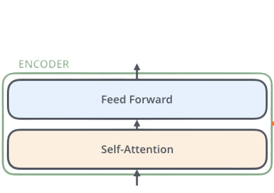
CLASSIC TRANSFORMER
Transformers are another Neural Network architecture and are able to capture long-range content by learning dependencies in the Data between distant positions in the Input and Output sequences.
In the classical architecture we have 2 fundamental components:
Encoding component, i.e. a stack of Encoders, all consisting of: a Self Attention Layer and a Feed Forward Neural Network and do not share weights.
Decoding component, that is, a stack of Decoders, which use the encoded information of the input sequence to generate the desired output, making use of the attention both between the words of the partial output and between the output of the Encoder and the partial output.

Slide 21

SIMPLIFY TRANSFORMER
The second model analyzed in this report is a simplified Transformer with only the Encoder part and no Decoder part.
This means that the model is primarily designed to encode and process input, but is not designed to generate textual output based on this encoding.
This decision was made because the main objective is the prediction of time series based on numerical data, where there is no need to generate sequences of text or other sequential output.
The encoder can be used to extract meaningful patterns and features from historical data, which can then be used to make predictions.

Slide 22
HYBRID MODEL : MIXTURE
The hybrid mixture model is a machine learning model that combines two popular deep learning models for time series prediction: the Bi-LSTM and Transformer models and works as follows:
- Time series data are first fed to the Bi-LSTM and Transformer models that learn the temporal dependencies in the data and produce a prediction for the future value of the time series.
- The predictions of the bi-LSTM model and the transformer model are then combined using a weighted average via the Average() function.

Slide 23
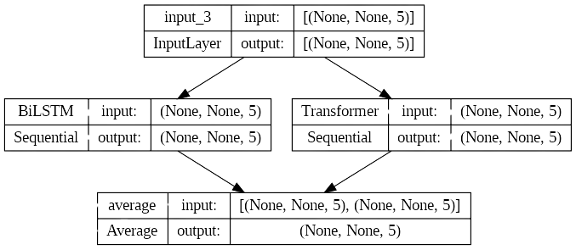
HYBRID MODEL : MIXTURE

Slide 24
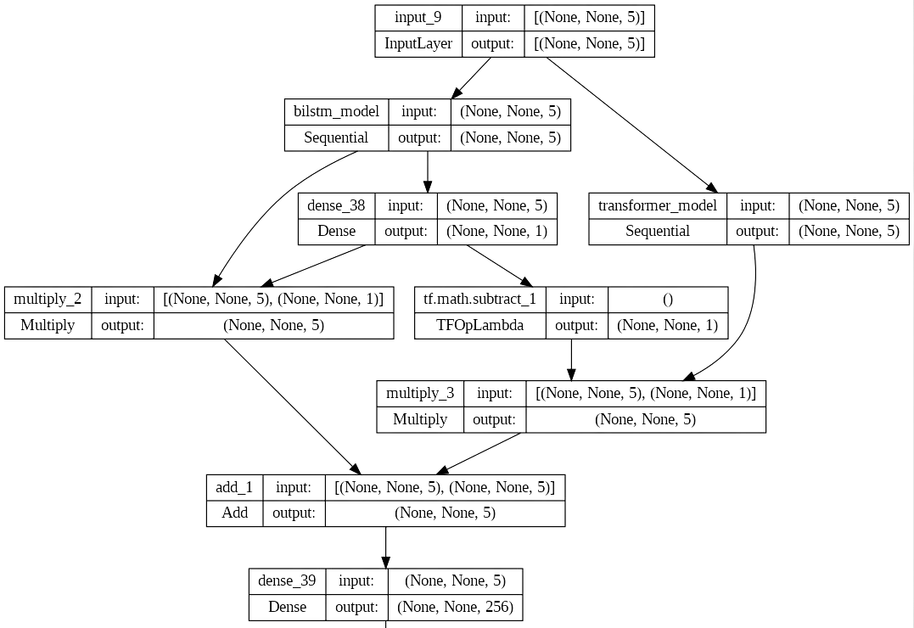

HYBRID MODEL: with WEIGHTED ATTENTION
The hybrid model with weighted attention represents an advanced implementation to address the challenge of forecasting financial time series, combining the approaches of Bi-LSTM and Simplified Transformer with Multi-headed attention.
First, the inputs are defined and passed to two distinct branches of the model:
- The first branch involves the Bi-LSTM model with Multi-attention.
- The second branch involves the Simplified Transformer, which also uses the multi-headed attention architecture described above.

Slide 25

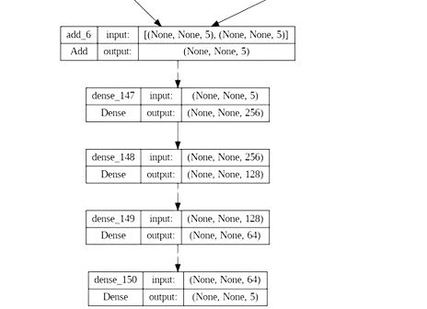
HYBRID MODEL: with WEIGHTED ATTENTION

Slide 26
HYBRID MODEL: with WEIGHTED ATTENTION

Slide 27






04
METRICS & RESULTS

Slide 28
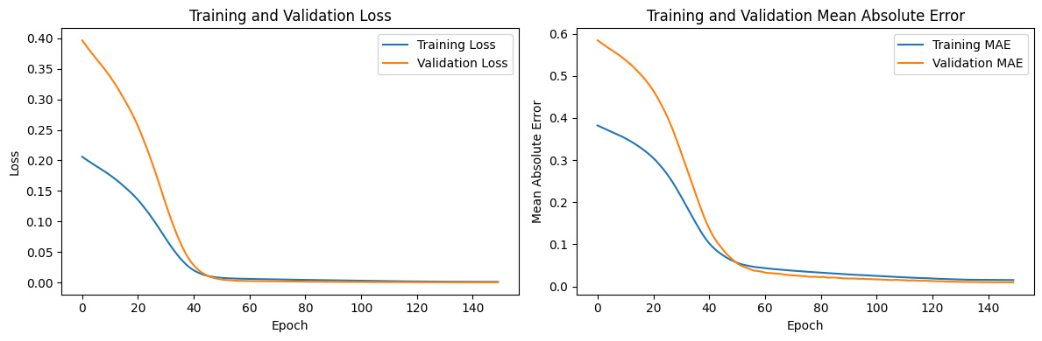
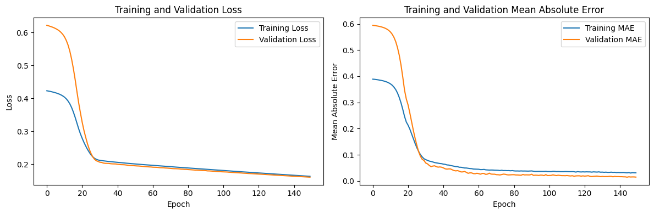
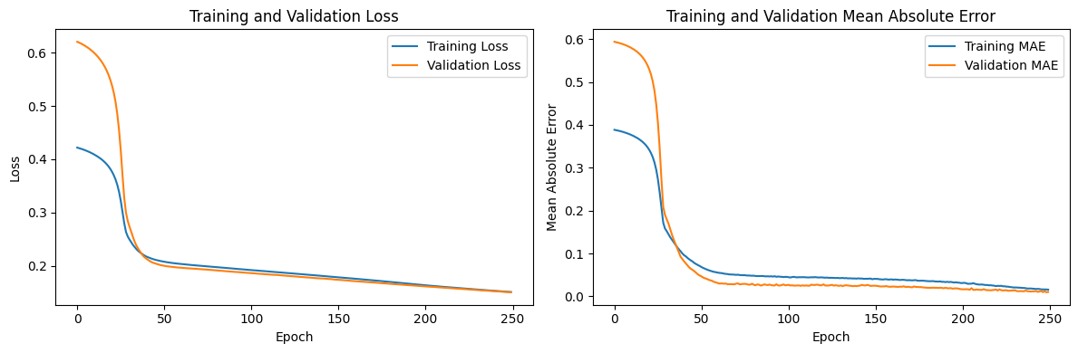
METRICS
LOSS: MSE
MAE
is a measure of the discrepancy between model predictions and actual values
measures the mean absolute error between model predictions and actual values in the test data.
RMSE
R-SQUARED
It is the square root of the mean of the squares of the differences between the predictions and the actual values in the test data.
measures how well the model fits the data compared to a model based on the mean.
LEARNING CURVES
GRAPHS & TABLES
are graphs showing how training and validation metrics vary as the number of training epochs increases.
Graphs and financial datasets showing us the difference between predicted and actual data.

Slide 29
MODELS RESULTS
We see the results of the 3 models on the Apple Dataset.
Every Training was done with 150 epochs, a batch-size of 64 and learning_rate=0.000015 with a 30% reduction callback.
TRANSFORMER
HYBRID MODEL
Loss MSE : 0.09
Mean Absolute Error (MAE): 0.014
RMSE: 0.0198
R-squared (R²): 0.89
Learning Curves:
Best Validation Loss: 0.0912 at epoch 150
Best Training Loss: 0.0914 at epoch 150
Loss MSE : 0.08
Mean Absolute Error (MAE): 0.017
RMSE: 0.018
R-squared (R²): 0.87
Learning Curves:
Best Validation Loss: 0.0823 at epoch 150
Best Training Loss: 0.0824 at epoch 150
Loss MSE : 0.05
Mean Absolute Error (MAE): 0.009
RMSE: 0.012
R-squared (R²): 0.901
Learning Curves:
Best Validation Loss: 0.0543 at epoch 150
Best Training Loss: 0.0544 at epoch 150

Slide 30
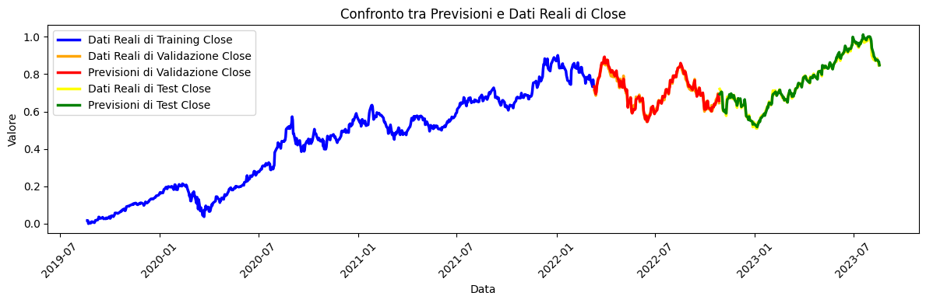
HYBRID MIXTURE MODEL : RESULTS
We see the results of the HYBRID MIXTURE model on the Apple Dataset:
The training was not done this time on the hybrid model, as it is a model that averages the training of the 2 previous models: BiLSTM and Simplify Transformer.
Mean Absolute Error (MAE): 0.01487
Root Mean Squared Error (RMSE): 0.0184
R-squared (R²): 0.88
When combining predictions from different models, it is important to ensure that the base models have good individual performance, as the quality of the predictions of the base models will affect the performance of the hybrid model.

Slide 31
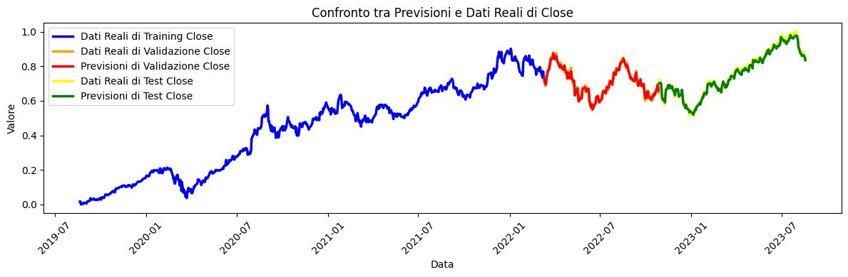
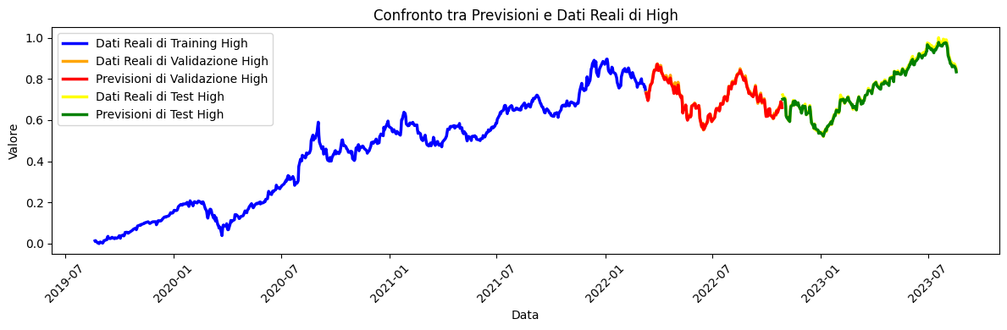


MODEL BI-LSTM: GRAPHIC RESULTS

Slide 32

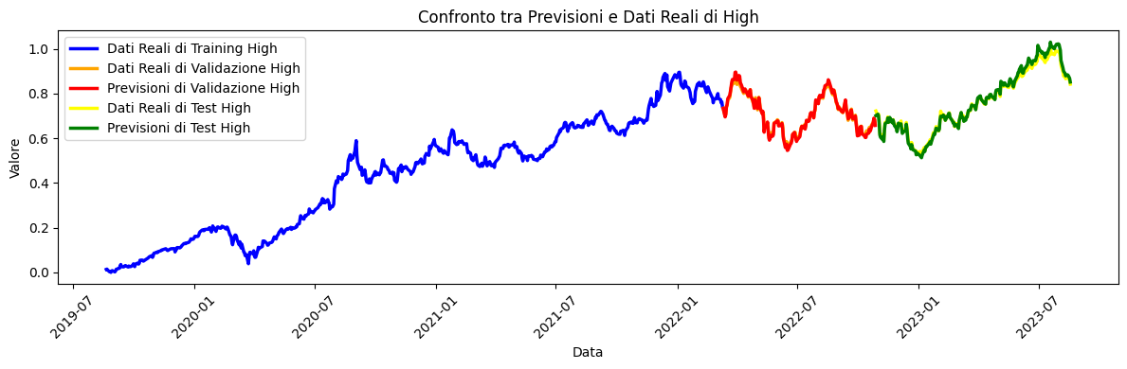
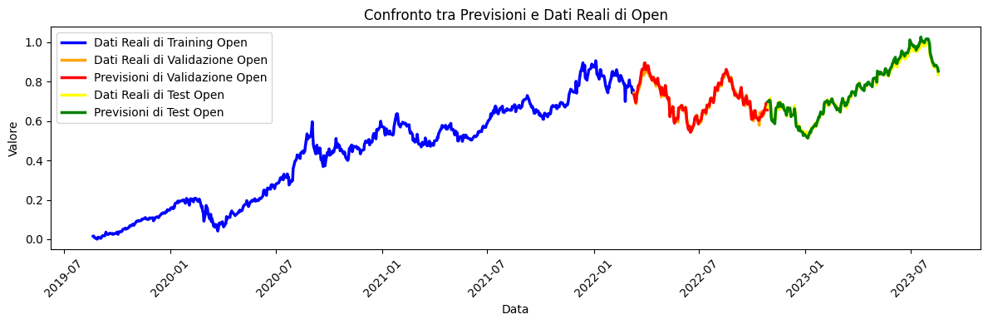

MODEL TRANSFORMER: GRAPHIC RESULTS

Slide 33








HYBRID MODEL : GRAPHIC RESULTS

Slide 34


FUTURE DEVELOPMENTS
CRATE A GRID SEARCH
To further improve hyper-parameters such as learning rate, dropout, number of units
IMPROVE THE TRANSFORMER
By adding a Bert like Masked self attention, Residuals or adding a Decoder component
IMPROVING MODELS
With better Optimizers (such as AdamW or Lion), with other Activations Function and Loss (L1smooth) etc.

Slide 35
THANKS FOR WATCHING!

